Slide 1
Notes:
UK Start up – sub 50 employees, with light VC funding (about a quarter million). It’s making use of the bitcoin and ethereum type block chains and before we get into what we do, lets start things off by discussing a current problem.

Slide 2
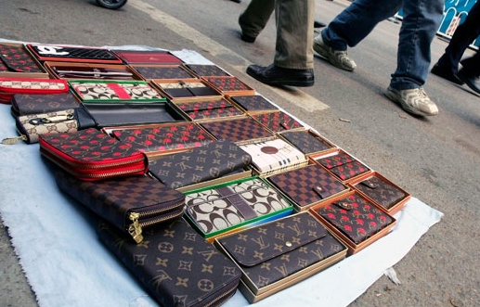
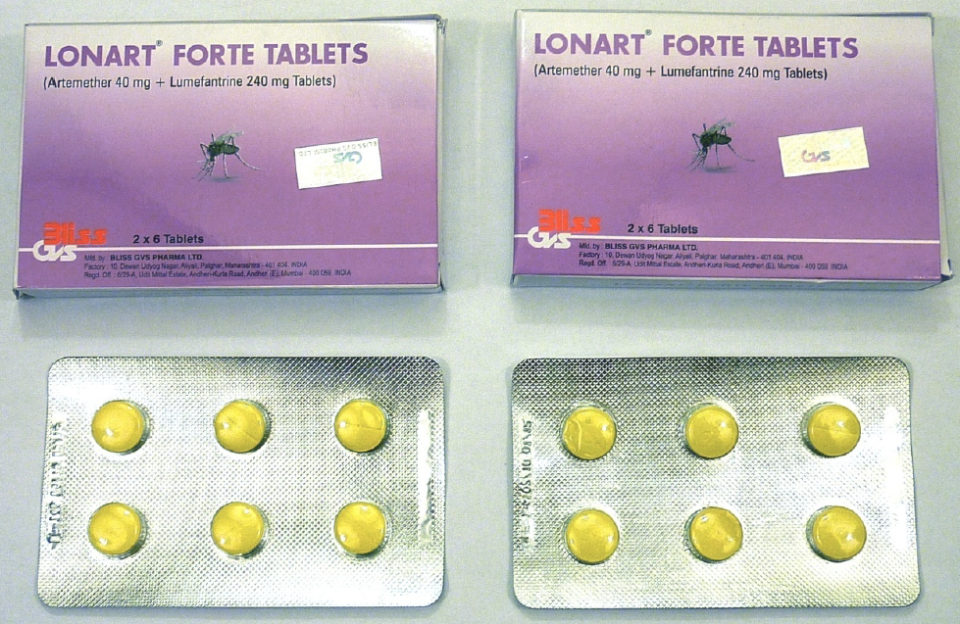
Traceability issues and a growing counterfeit market poses risks to both consumers and businesses alike
The problem
Risk
Trust issues:
Consumers cannot validate corporate claims of responsible/sustainable sourcing
Businesses have difficulty tracing all inputs in their supply chain
Counterfeit products at a glance:
Market worth over $460 billion
Strong association with organized crime
Impact to consumers is highly varied
Why are counterfeits dangerous?
Consumer satisfaction & safety
Brand image and economic risk

Slide 3
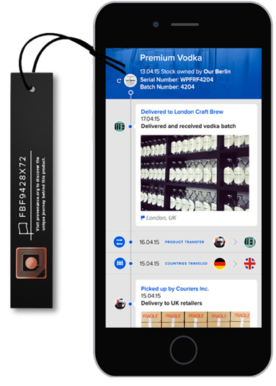
Provenance can use blockchain technology to put consumer and corporate minds at ease
Provenance 101
Provenance gives answers
Does this seller own the product?
Is this product ‘real’?
Are the details of the product’s sourcing factually accurate?
Has this product been owned before?
How old is the product?
Who are my customers?
Partnership Opportunities
Warranty information
Full product ownership and service history

Slide 4
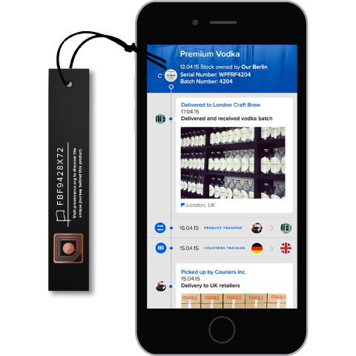
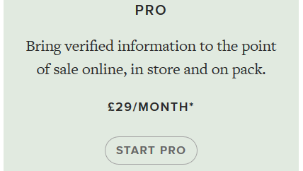
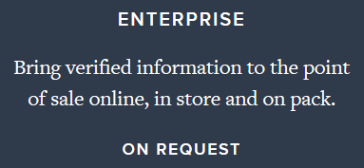
Provenance offers value to both businesses and shoppers alike, and is scalable to meet enterprise demand
The Pitch
For business
For shoppers
Rich supply chain & customer data
Product story & peace of mind
Input tracing
Procedure verification
Item level and batch level tracking
Product self-promotes
Customer data*
Re-sale data*
Affordable pricing
Transparent pricing
Strong scalability
Custom-tailored solutions available
Authenticity verification
Availability of product’s story & history

Slide 5
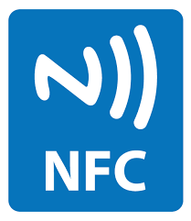
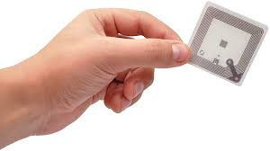
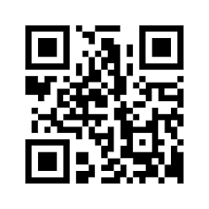
Open Traceability for the Material World
Technical details
Public vs private Chain
Connecting the physical
NFC tag for high value items
2D codes for low value items
Public Permissioned Blockchain
Equality, consensus, network effect
Key Improvement:
Non-localization: A truly global computer running by consensus.
Security: Unforgeable digital signature reducing operating risks.
Auditable: every operation and interaction recorded and archived.

Slide 6
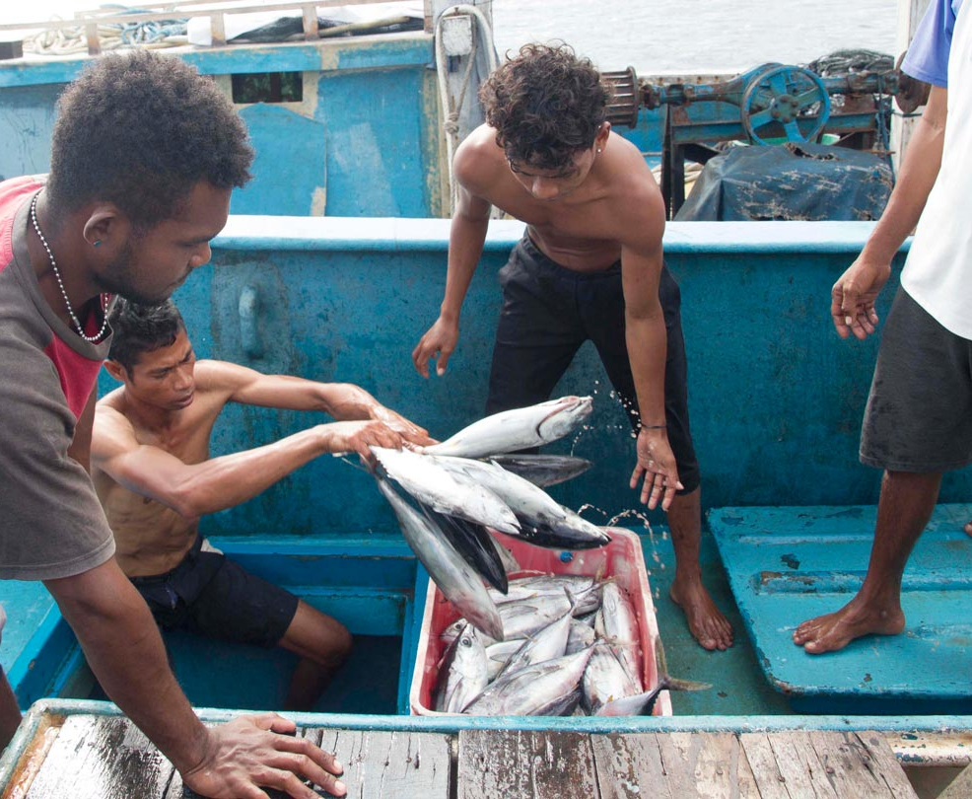
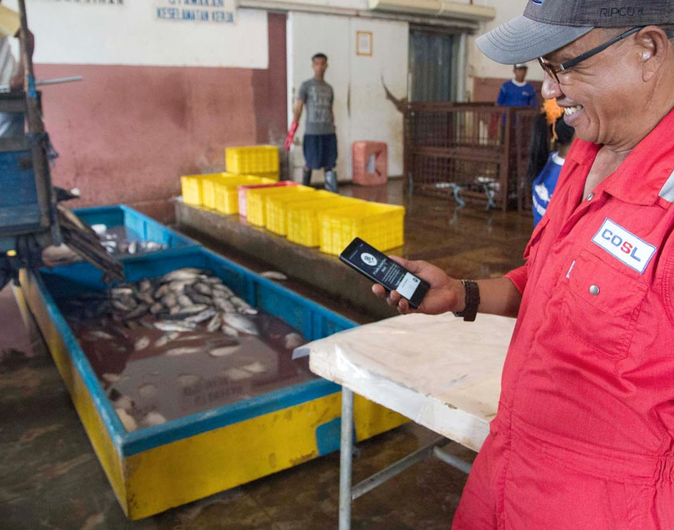
Provenance at work in the SE Asian fishing industry
Ocean-to-table

Slide 7
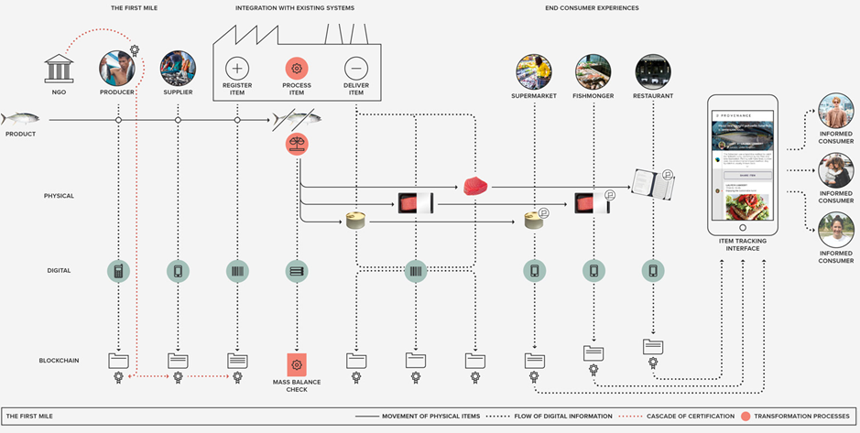
Provenance has proven it works from start to finish, and integrates with the majority of systems already in place
Ocean-to-table

Slide 8
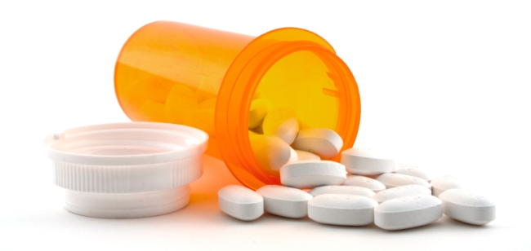
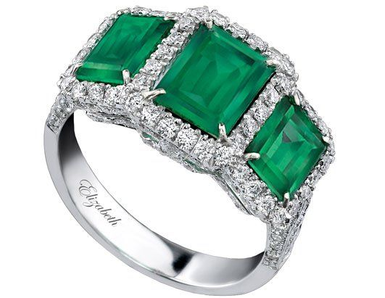
Provenance must overcome pricing and security challenges in order to reach its market potential
Moving forward
Diversification into new industries
Focus on manufacturers of luxury goods and pharmaceuticals
Emphasis on high-risk products (art, jewelry), particularly from non-brand retailers
Data analytics
Value of data in blockchain (supply chain optimization, quality control)
Risks
Pricing model
Currently based on SKUs, not on the usage volume or value Provenance can provide to businesses
Security outside the blockchain environment
Transfer of tag from legitimate to counterfeit products
Addition of false data or omittance of undesirable data

